Slide 1



An introduction to shell programming
Variables and conditionals
1
Shell programming: variables and conditionals

Slide 2
Why Shell programming?
Shell programming is about building (Shell) scripts.
The scripting language can use any of the commands you’ve seen so far. It also comes with variables, conditionals, loops, functions, etc.
If you regularly need to do something and there is no command for it... script it!
2
Shell programming: variables and conditionals

Slide 3



Why Shell programming?
A large portion on UNIX administration and house keeping is done via shell scripts because it’s one of the most powerful features of the UNIX system!
Writes scripts
Writes scripts
Writes scripts
3
Shell programming: variables and conditionals

Slide 4

Why Shell programming?
Good practices that you’ve seen for other scripting languages also apply here...
4
Shell programming: variables and conditionals

Slide 5



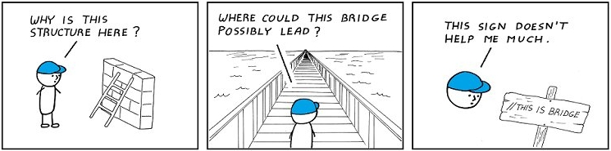
Why Shell programming?
No error
Does what it’s supposed to do
Reusable
No unnecessary work
Clear logic
5
Shell programming: variables and conditionals

Slide 6

Why Shell programming?
Before you start writing the script, you should know:
what information you need and how you’ll store it.
whether you need to create files. If so, where and with which permissions.
what commands you will use.
whether the user needs notifications.
Basically, you should know exactly what you’re going to code before you start typing. You’re not supposed to figure out stuff as you go along.
6
Shell programming: variables and conditionals

Slide 7

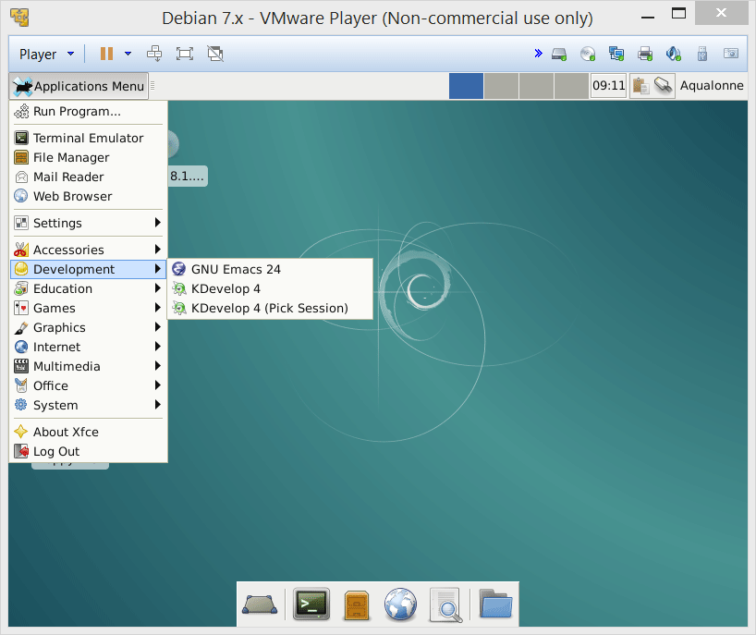
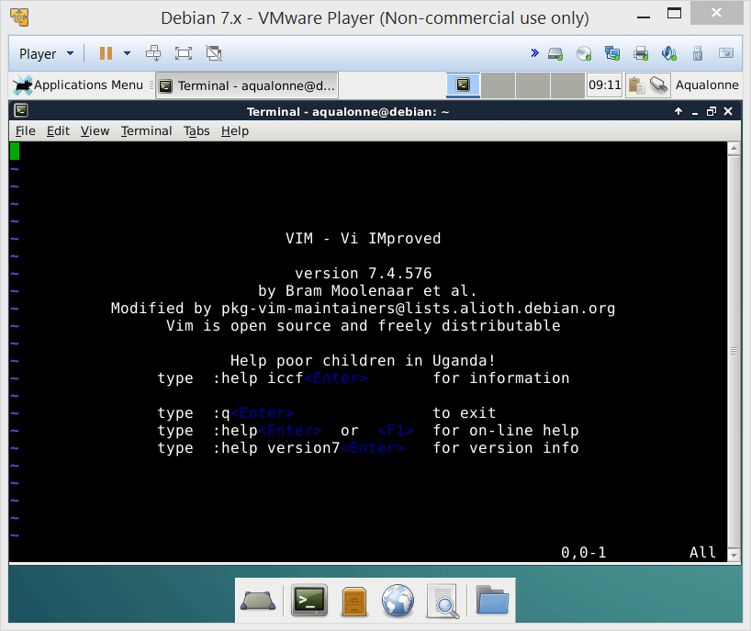
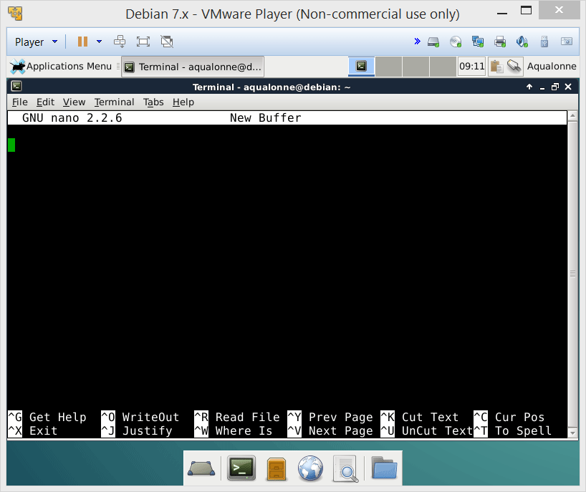
Basics of writing and running a script
To be productive, it’s still better to use a graphical editor. They have keyboard shortcuts AND a mouse!!
There are also editors accessible from the Shell: vi, and nano.
You need to install vim
If you’re remotely logged on a machine and need to edit a script, then use vim/nano
Ctrl+X is how you get out of this...
You can install graphical editors such as emacs or Kdevelop
(using apt-get install)
I’ll give examples using a variety of editors.
7
Shell programming: variables and conditionals

Slide 8
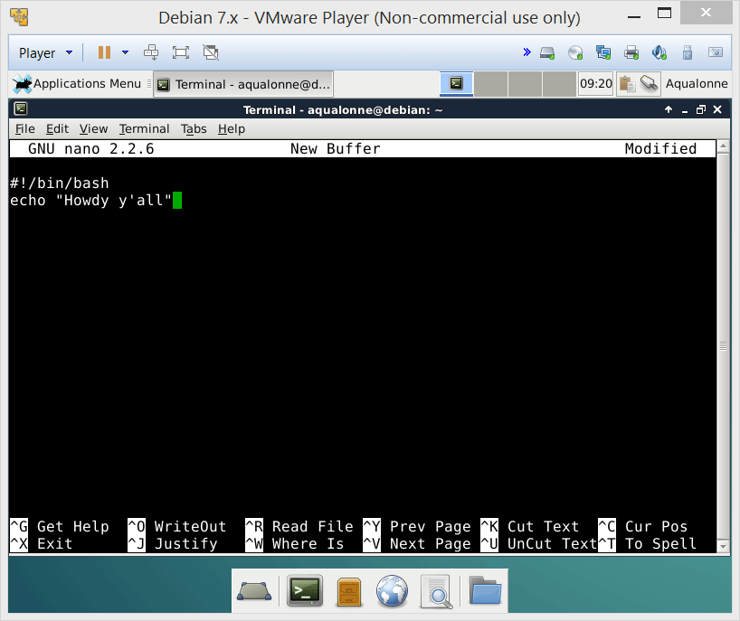
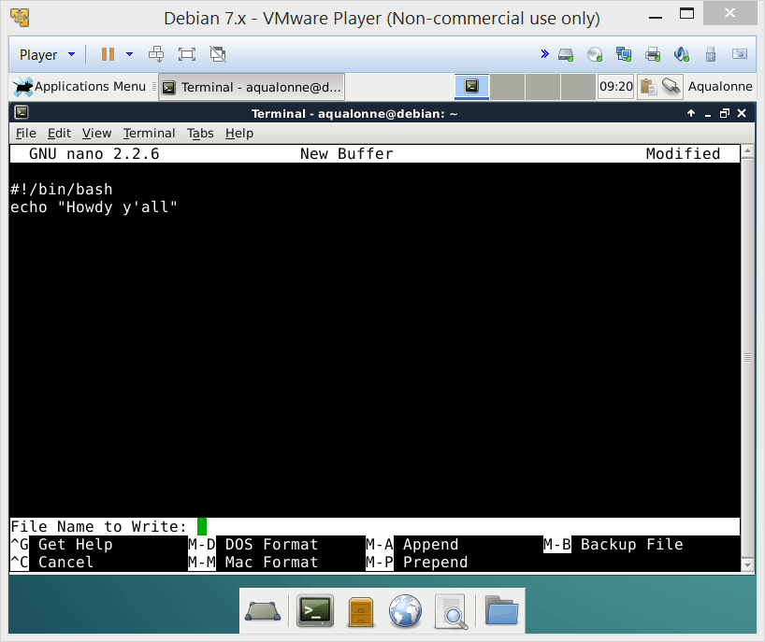
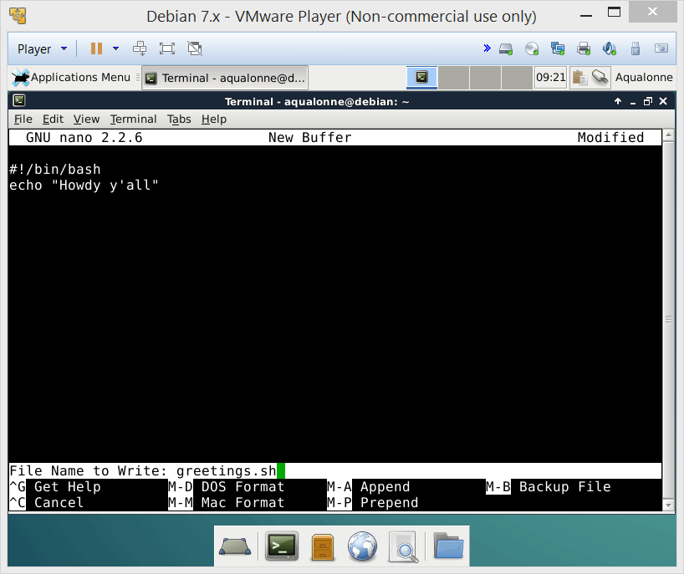
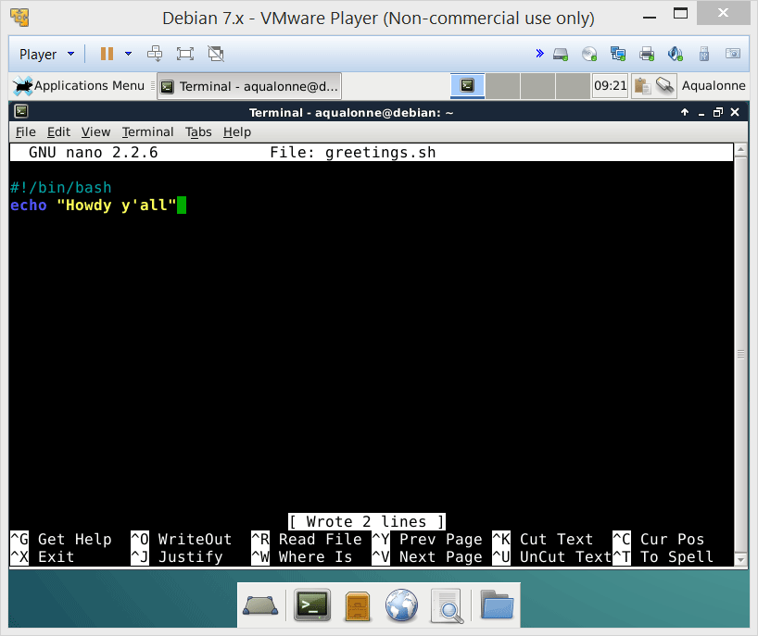
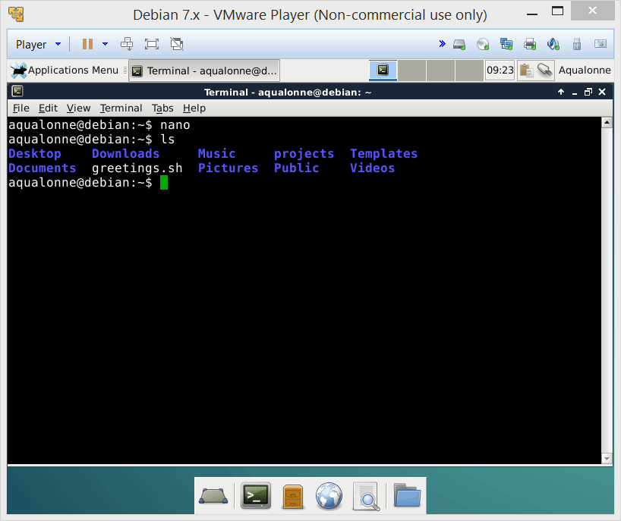
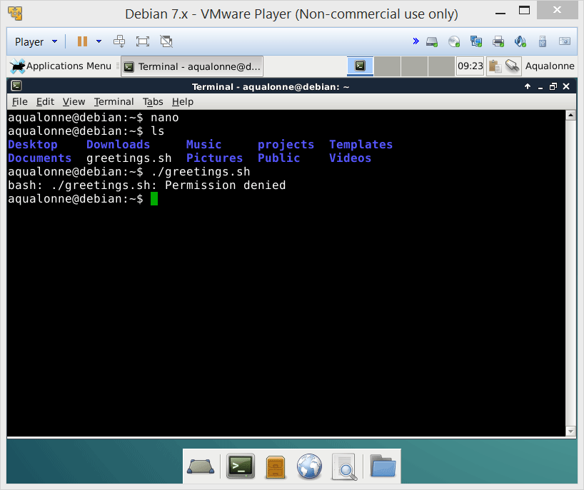
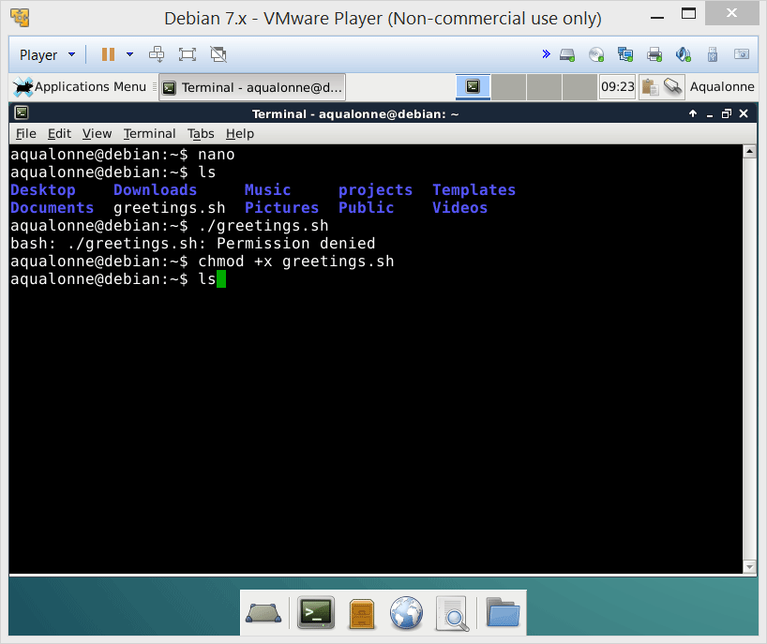
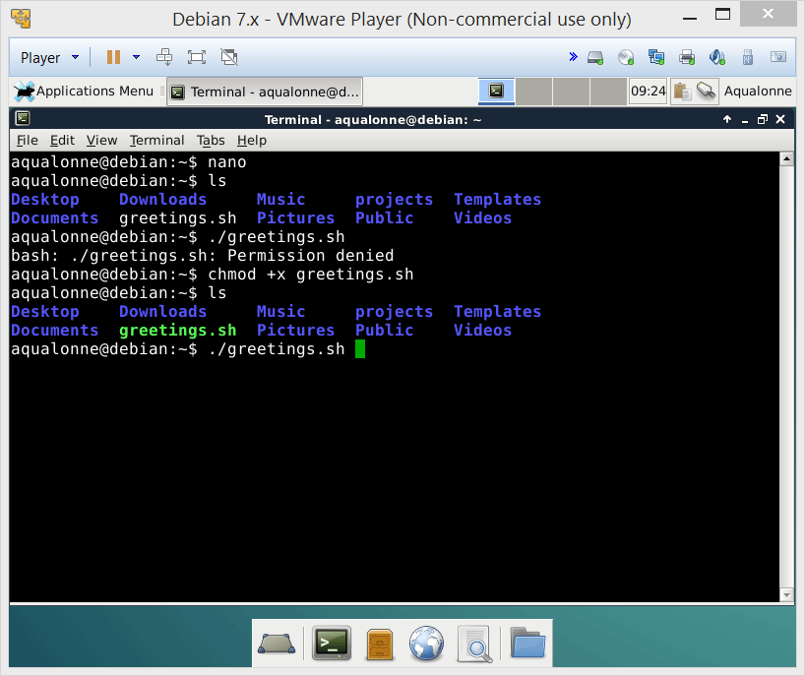
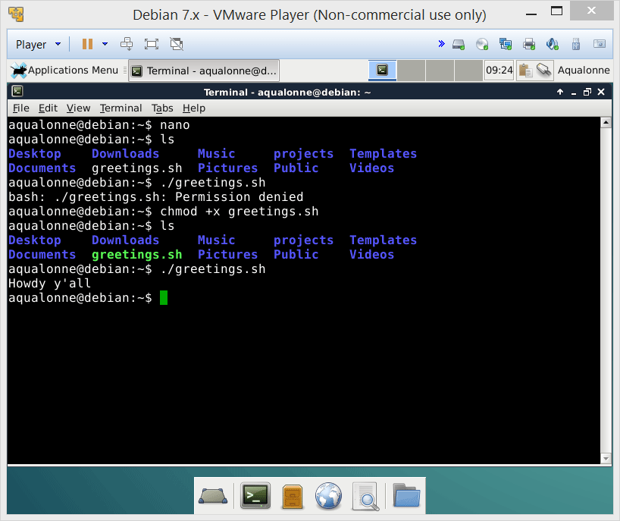
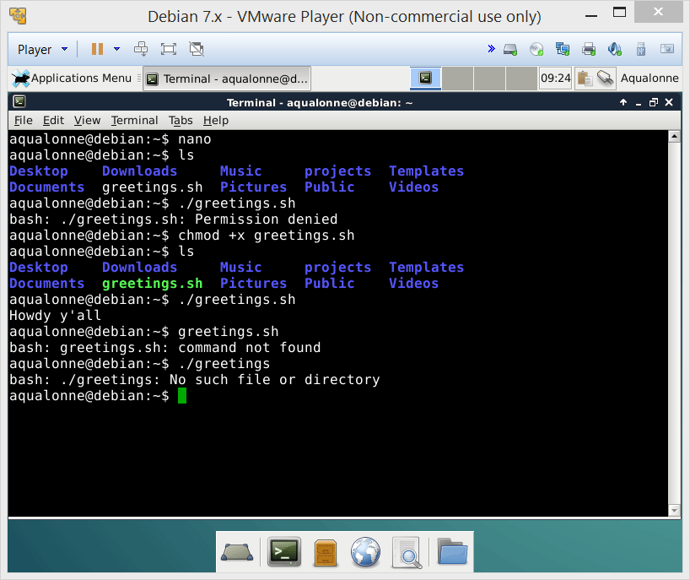

Basics of writing and running a script
Top line of your file must be
#!/bin/bash
The file should be saved with the extension .sh
Add permissions: chmod +x
Call it like ./name.sh
# is a comment
8
Shell programming: variables and conditionals

Slide 9
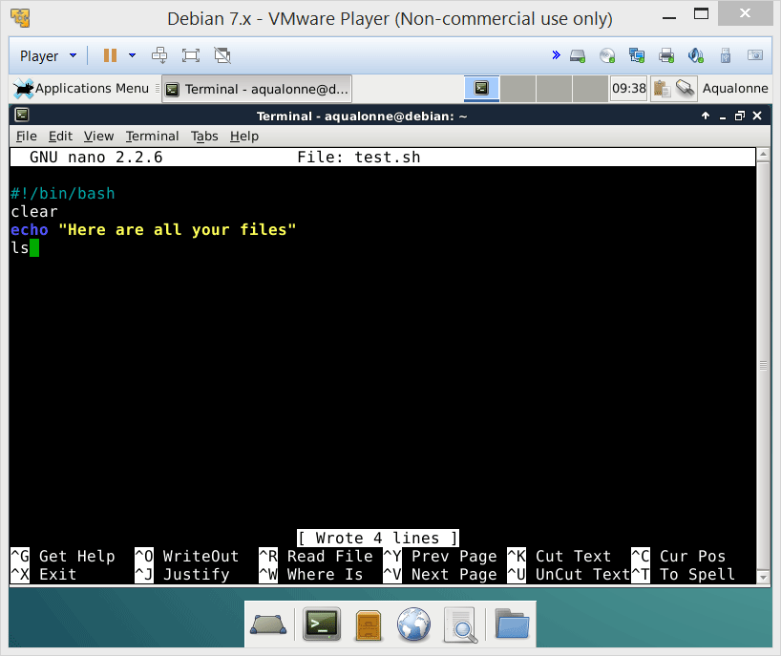
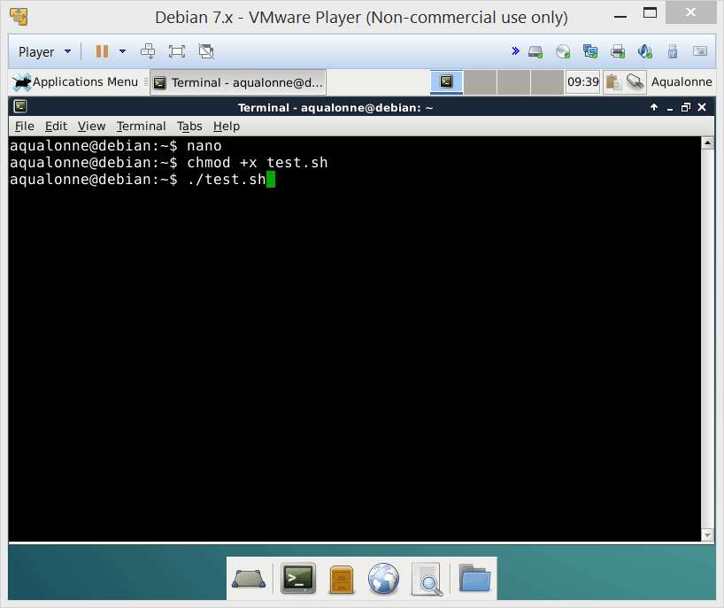
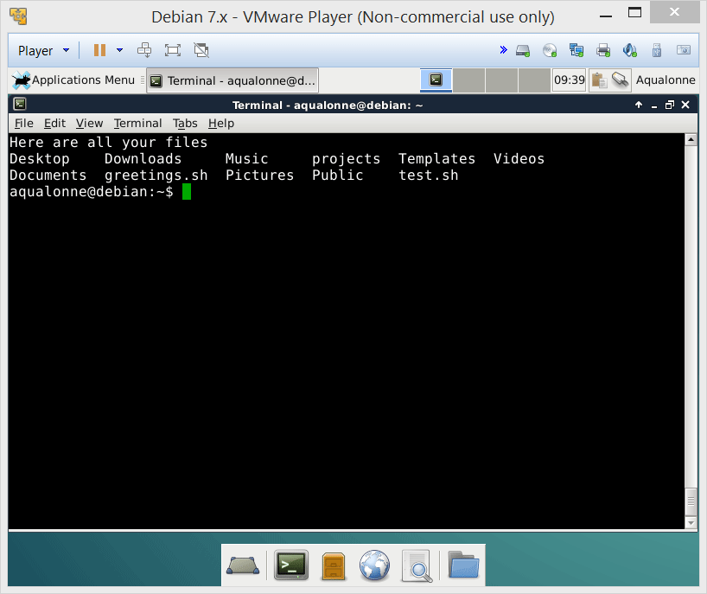
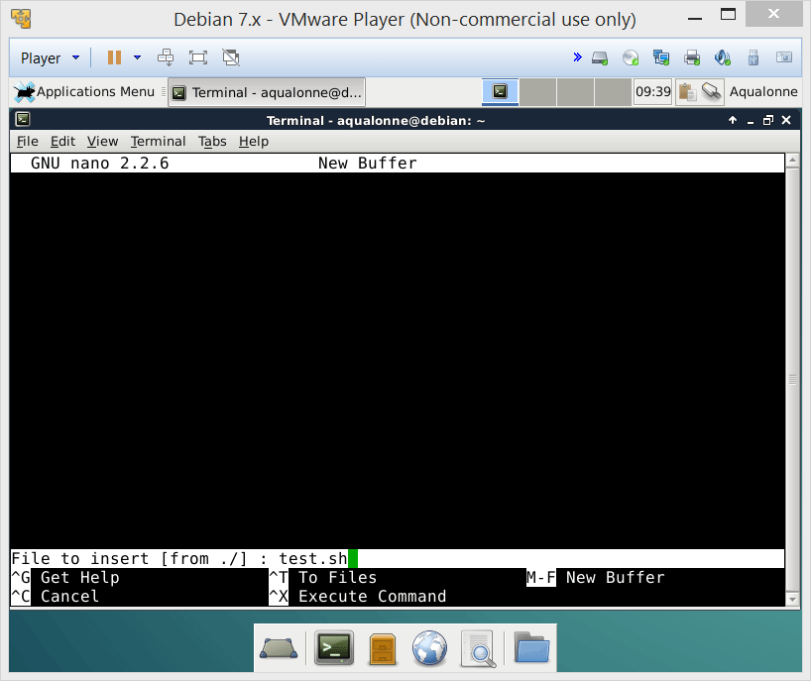
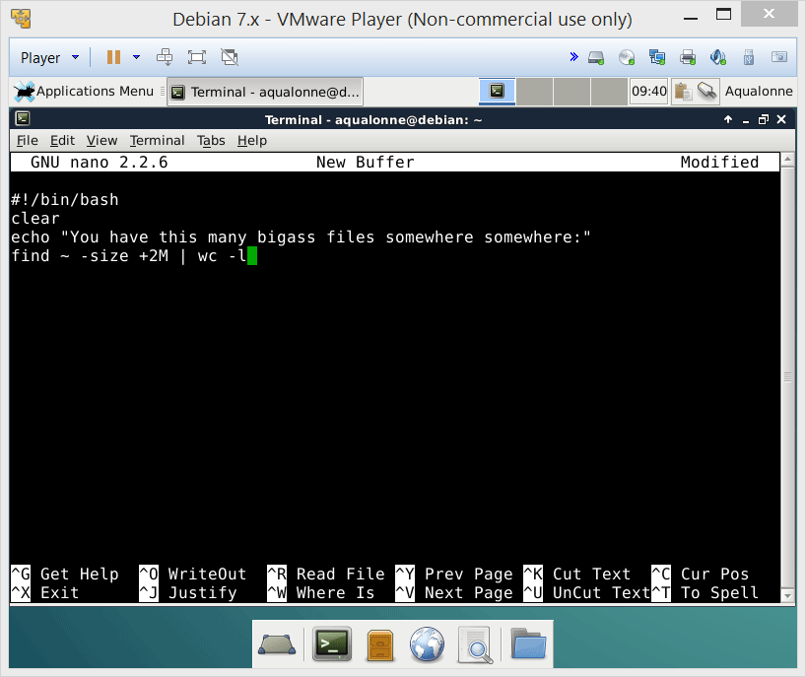
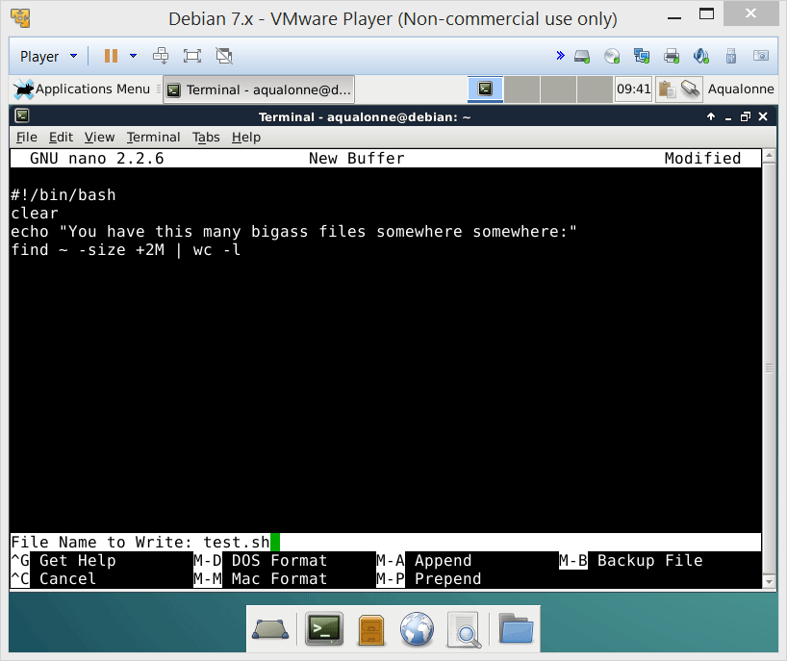
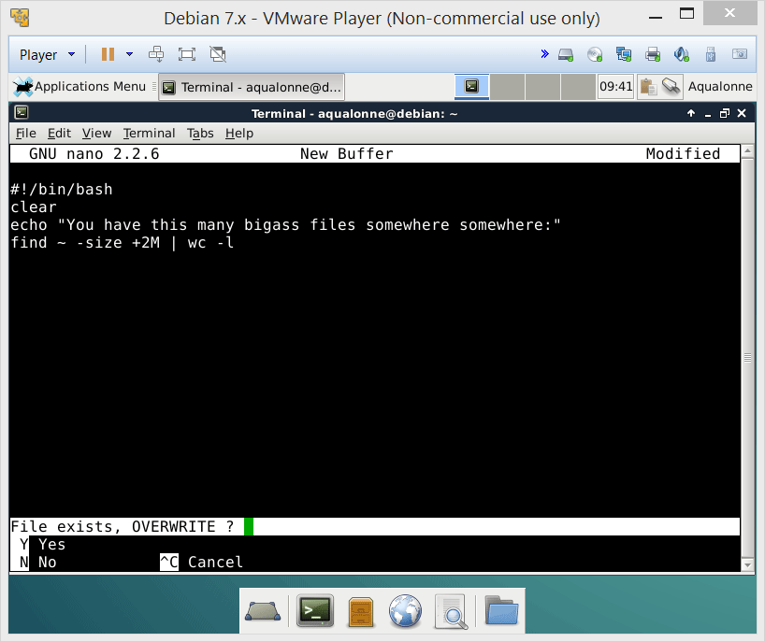
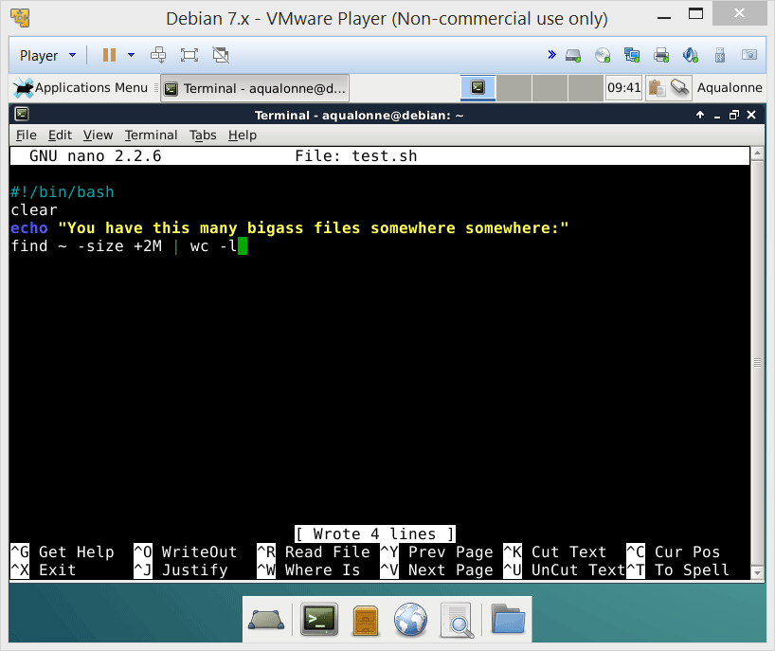
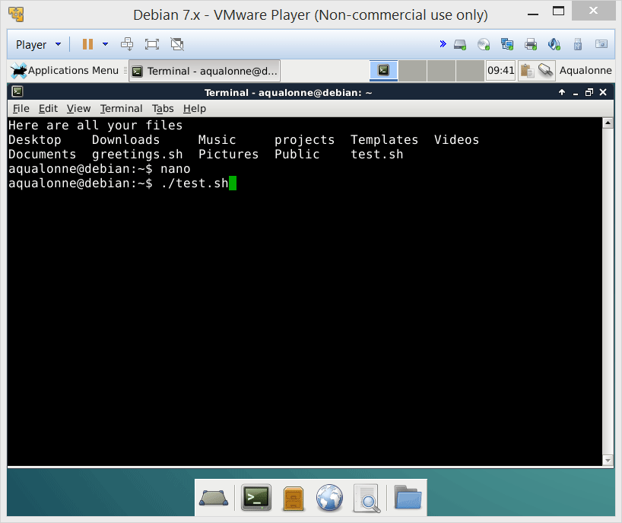
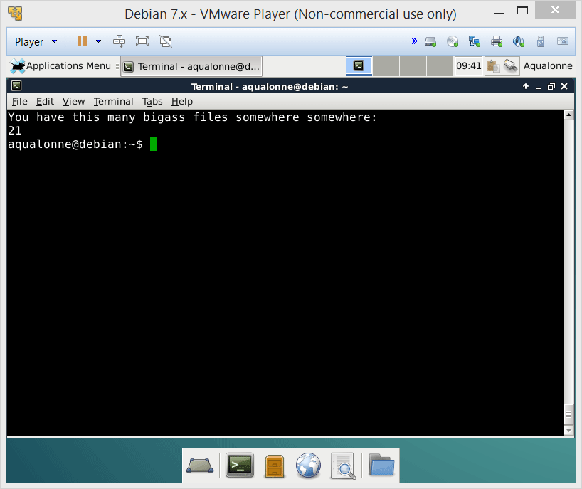
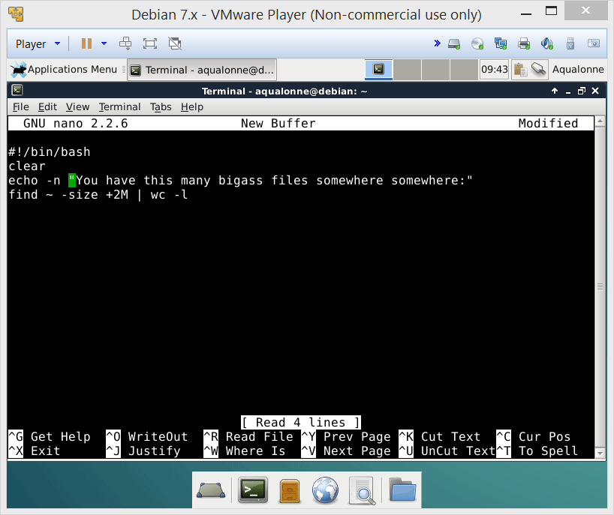
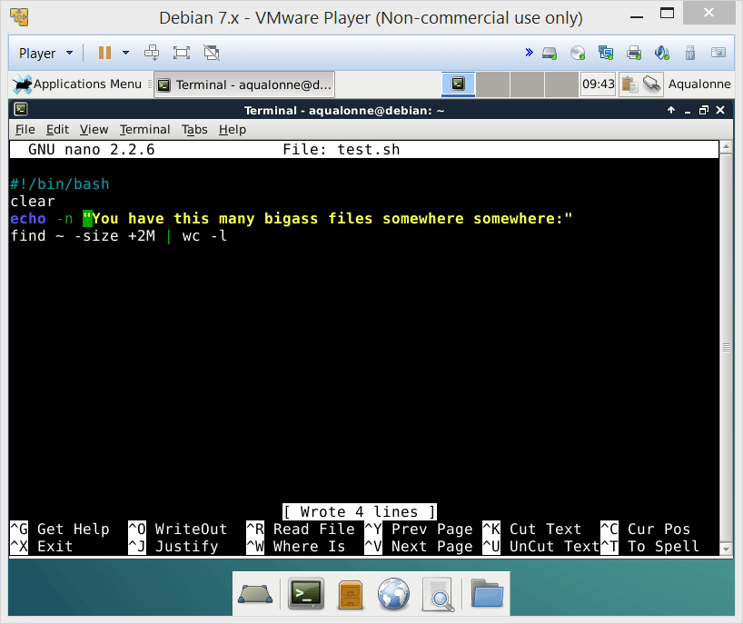

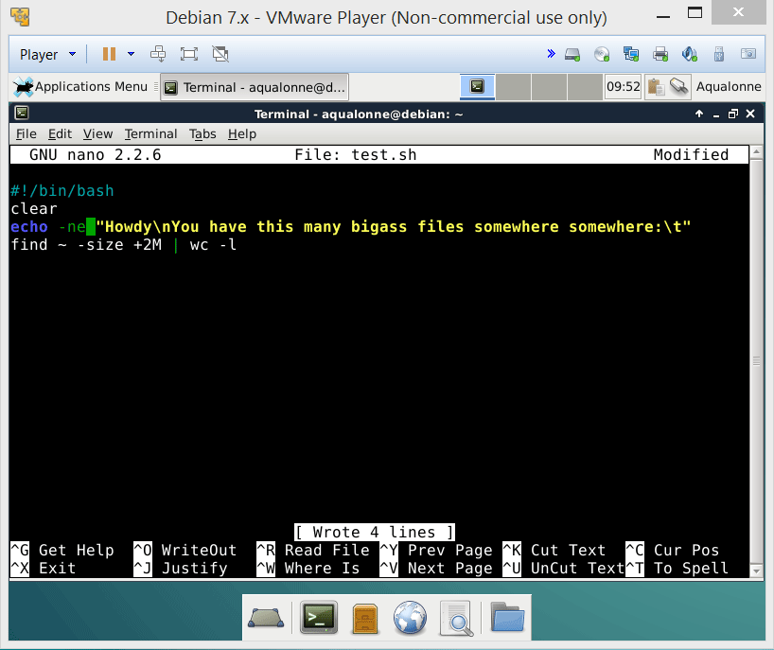

Basics of writing and running a script
For basic displays, use echo
It has 2 options:
-n deletes default end of line
-e enables escape sequences
\t tab
\n new line
9
Shell programming: variables and conditionals

Slide 10
Variables
Variables can come from three ways:
You create them in your code
They are part of the user’s environment (e.g., user id)
They are passed as arguments to the script
Regardless of where they come from,
$name refers to a variable
10
Shell programming: variables and conditionals

Slide 11
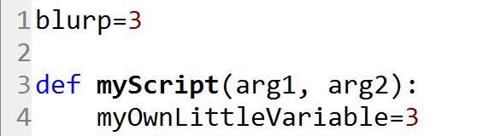
Variables
This is not new... You see the same sort of stuff in other languages. Take Python as metaphor.
Variable created outside your script
Access is easy but you need to write extract stuff to change
Arguments to the script
Typically not useful to change them
Variable that you create in your script
11
Shell programming: variables and conditionals

Slide 12

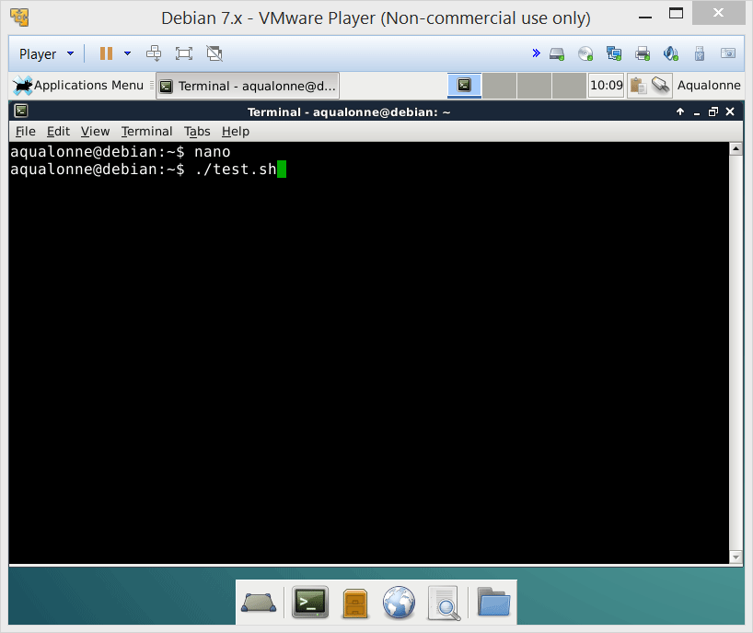
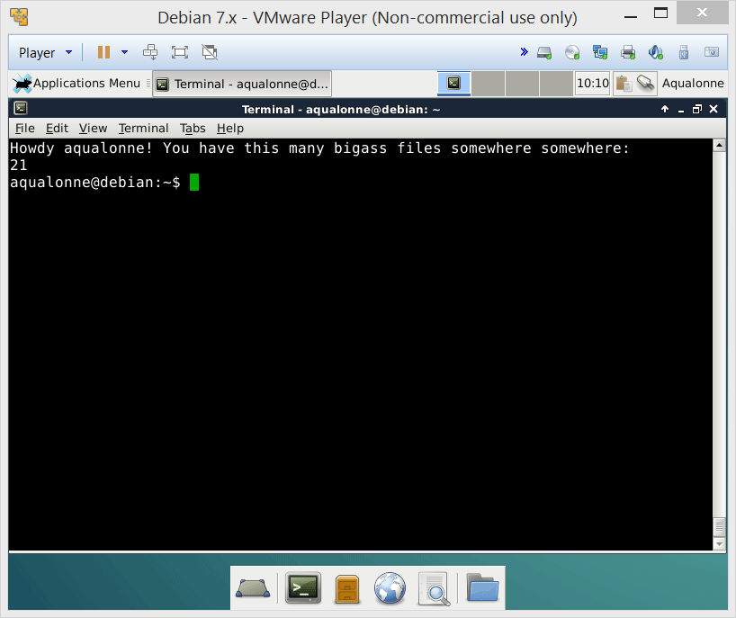

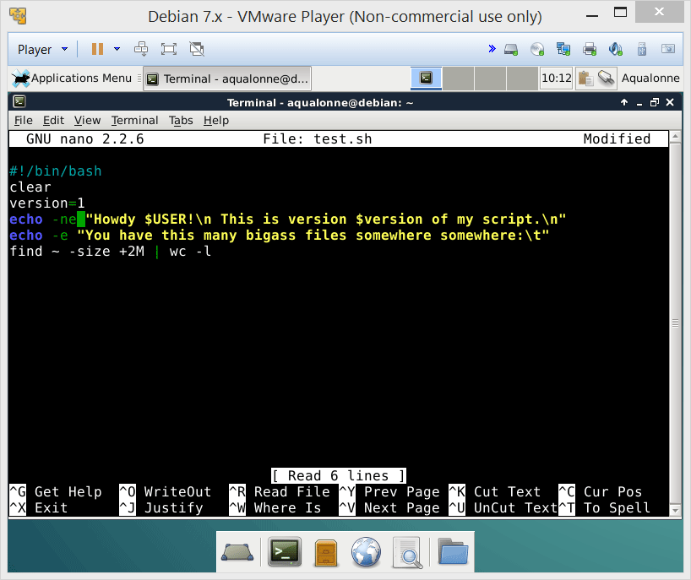
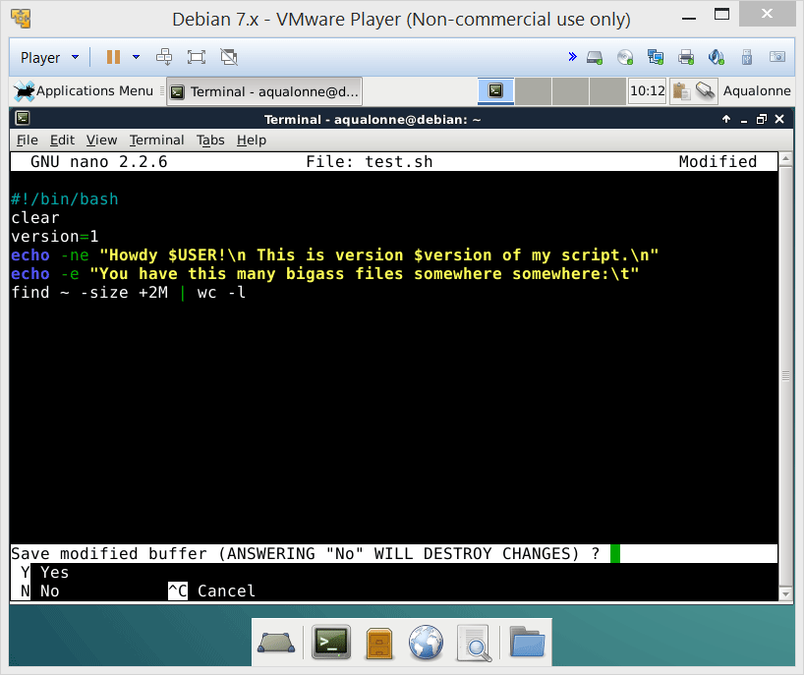
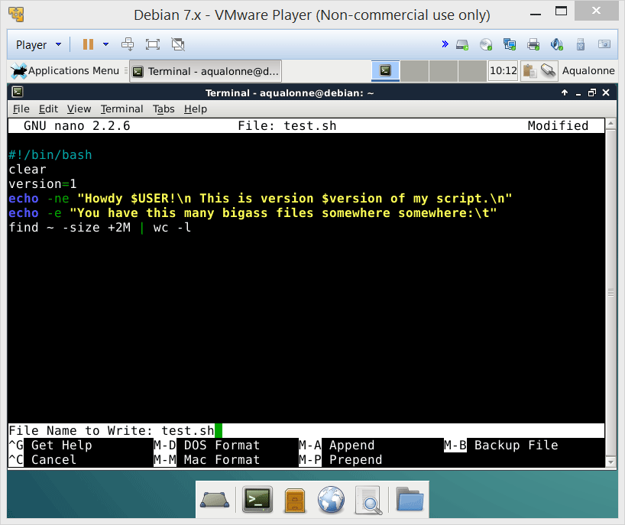

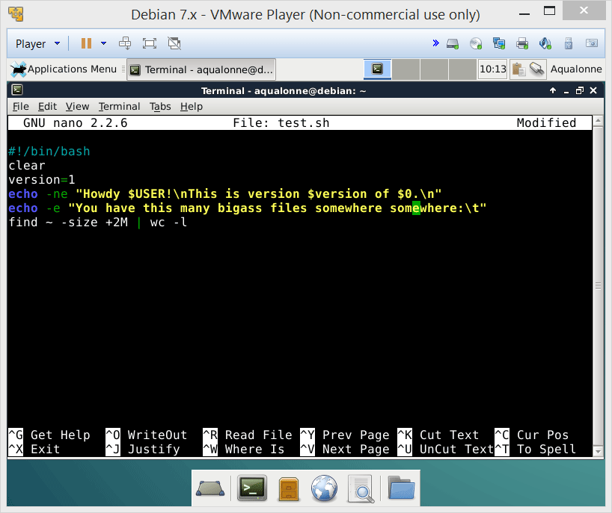

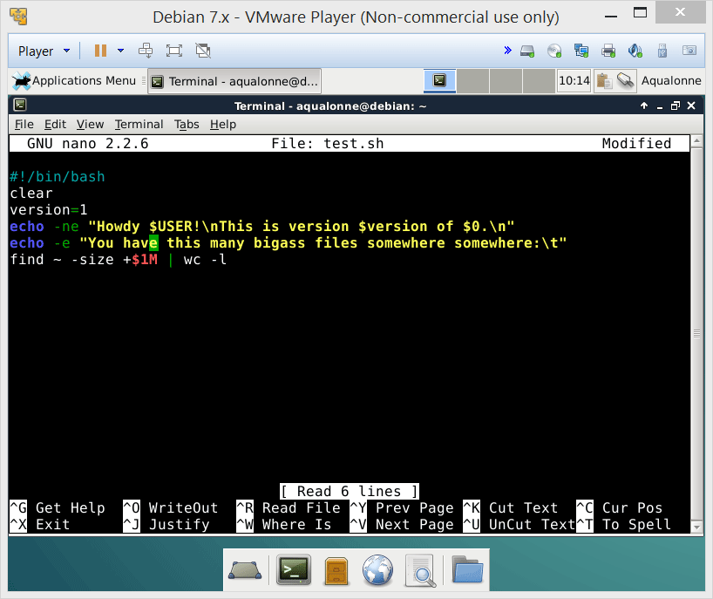





Variables
12
Shell programming: variables and conditionals

Slide 13
Variables
You create them in your code
They are part of the user’s environment (e.g., user id)
They are passed as arguments to the script
variable=value NO SPACE!
$USER All in capital
$0 Script’s name
$# Number of arguments
$1, $2, ..., $9 Arguments
${10}, ... Differs from $1
13
Shell programming: variables and conditionals

Slide 14

Variables
Note that variables are typed. You have:
integers myVar=3
strings myVar=“Hi”
arrays
constants
14
Shell programming: variables and conditionals

Slide 15
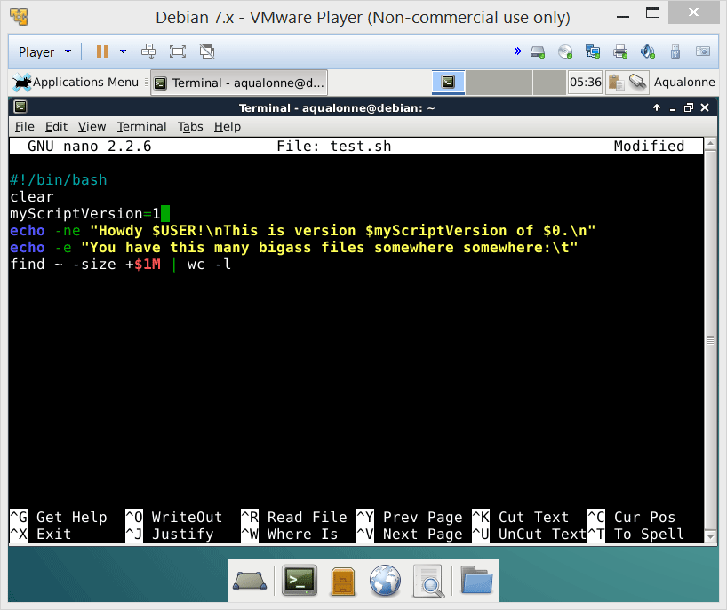
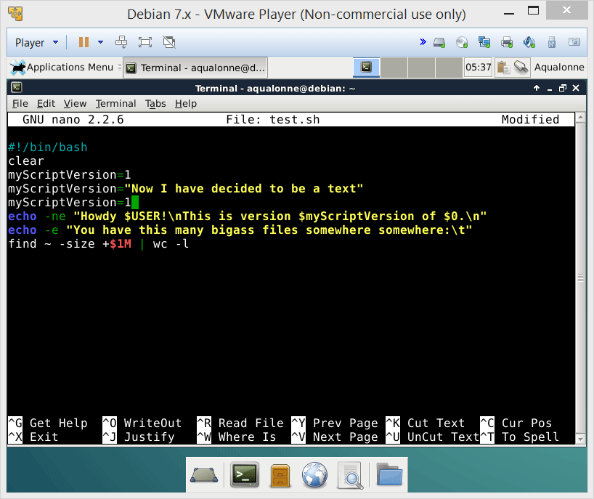
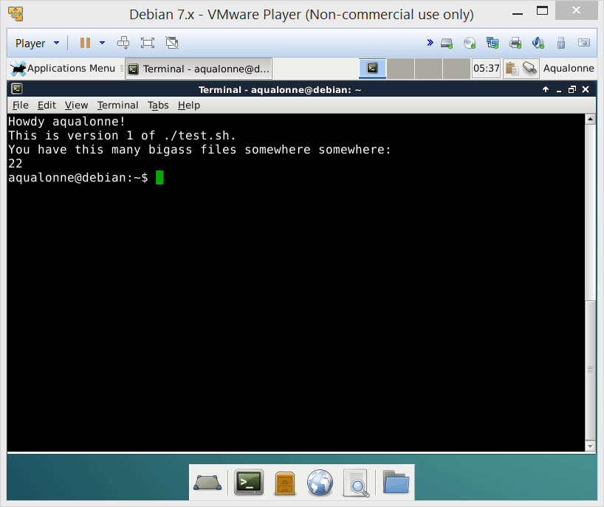
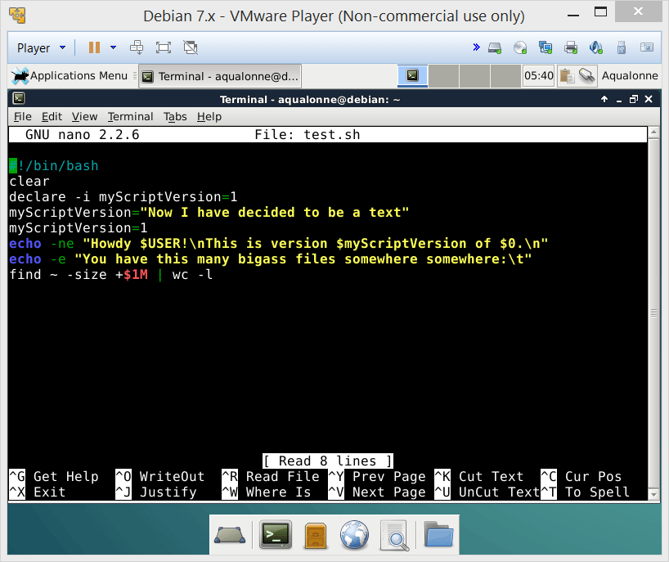

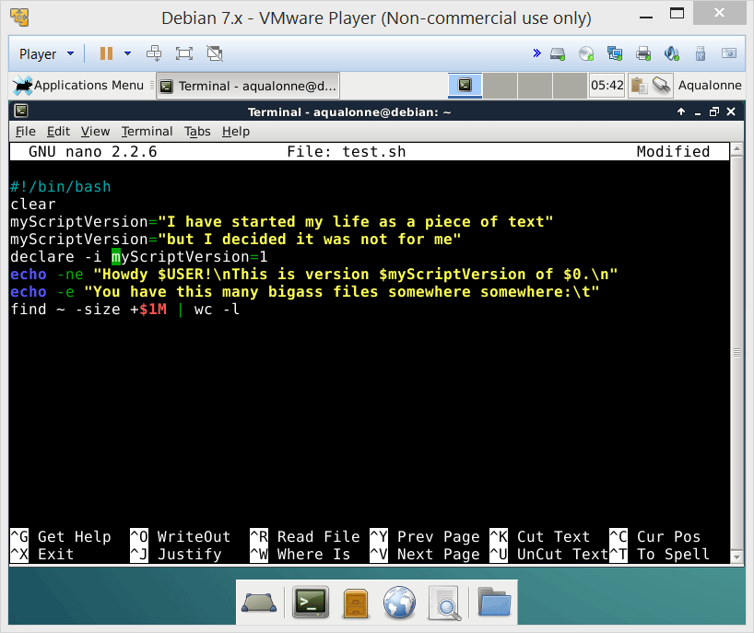

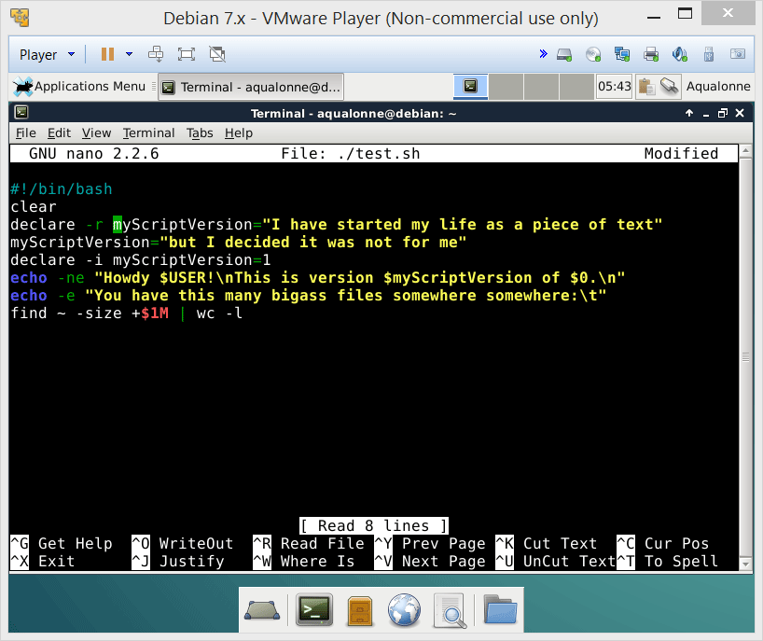

Variables
declare is how you force a variable to behave in one way from there on
-i is to force it as integer
-r is to force it as read only
15
Shell programming: variables and conditionals

Slide 16
Variables
You’ve seen how to lock the use that someone could make of a variable.
Why would you ever want to do that?
NOT for performances
Rather, for program logic
The script might be long and you start forgetting what a variable was for. Or something may one day start changing your script and you want to make sure they don’t do stupid stuff.
16
Shell programming: variables and conditionals

Slide 17

Variables
variables
Variables also have a scope. If you create them in a script they die at the end of the script, unless you save them.
17
Shell programming: variables and conditionals

Slide 18
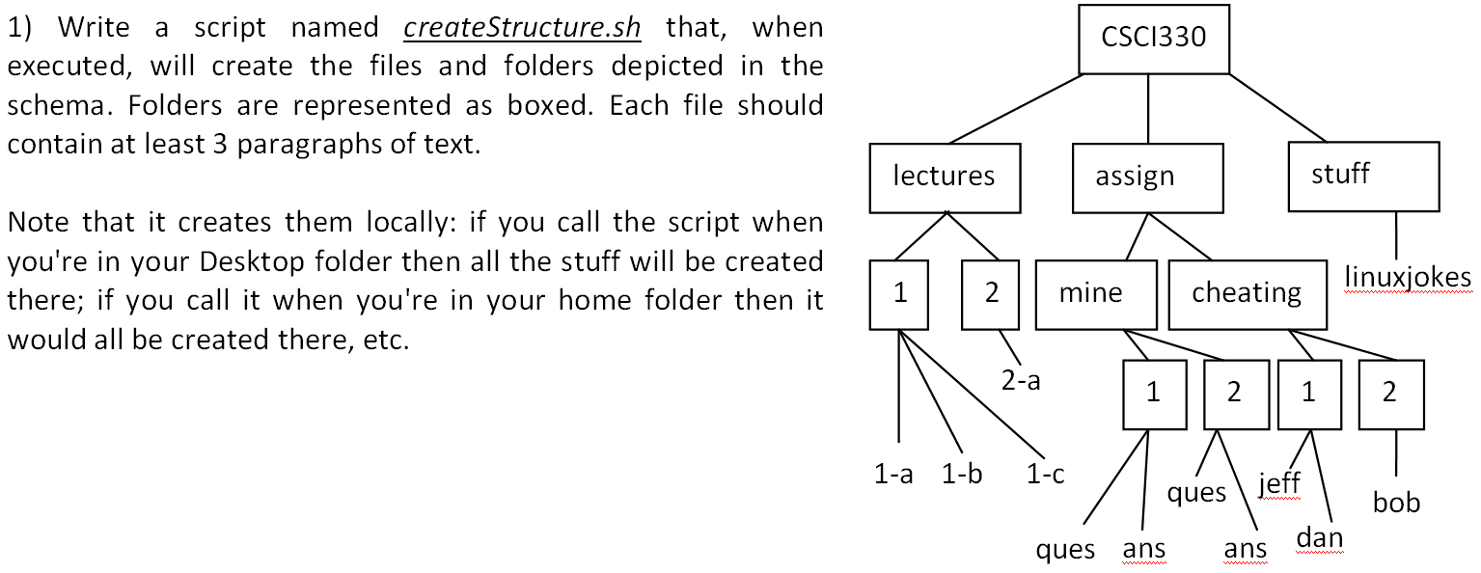
Script practice
18
Shell programming: variables and conditionals

Slide 19

Script practice
I can do it just like on shell.
Make a folder, go in it, make a file.
Then go to the other folder, etc.
Relative path
19
Shell programming: variables and conditionals

Slide 20
Script practice
#!/bin/bash
mkdir -p CSCI330/lectures/1
cd CSCI330/lectures/1
touch 1-a
touch 1-b
touch 1-c
lorem -p 3 > 1-a
lorem -p 3 > 1-b
lorem -p 3 > 1-c
cd ..
mkdir 2
cd 2
touch 2-a
lorem -p 3 > 2-a
cd ..
cd ..
mkdir -p assign/mine/1
cd assign/mine/1
touch ques
touch ans
lorem -p 3 > ques
lorem -p 3 > ans
cd ..
mkdir 2
cd 2
touch ques
touch ans
lorem -p 3 > ques
lorem -p 3 > ans
cd ..
cd ..
mkdir cheating
cd cheating
mkdir 1
mkdir 2
cd 1
touch jeff
touch dan
lorem -p 3 > jeff
lorem -p 3 > dan
cd ..
cd 2
touch bob
lorem -p 3 > bob
cd ..
cd ..
cd ..
mkdir stuff
cd stuff
touch linuxjokes
lorem -p 3 linuxjokes
20
Shell programming: variables and conditionals

Slide 21

Script practice
51 lines
21
Shell programming: variables and conditionals

Slide 22

Script practice
I don’t need to go in each
folder. I can just create files and
folders while staying where I am.
Absolute-ish path
22
Shell programming: variables and conditionals

Slide 23
Script practice
#!/bin/bash
#create CSCI330 directory
mkdir ./CSCI330
#create lectures directory and content
mkdir ./CSCI330/lectures
mkdir -p ./CSCI330/lectures/1
mkdir -p ./CSCI330/lectures/2
lorem -p 3 > ./CSCI330/lectures/1/1-a
lorem -p 3 > ./CSCI330/lectures/1/1-b
lorem -p 3 > ./CSCI330/lectures/1/1-c
lorem -p 3 > ./CSCI330/lectures/2/2-a
#creates the assign directory and all of its sub-content
mkdir ./CSCI330/assign
mkdir -p ./CSCI330/assign/mine ./CSCI330/assign/cheating
mkdir -p ./CSCI330/assign/mine/1 ./CSCI330/assign/mine/2
mkdir -p ./CSCI330/assign/cheating/1 ./CSCI330/assign/cheating/2
lorem -p 3 > ./CSCI330/assign/mine/1/ques
lorem -p 3 > ./CSCI330/assign/mine/1/ans
lorem -p 3 > ./CSCI330/assign/mine/2/ques
lorem -p 3 > ./CSCI330/assign/mine/2/ans
lorem -p 3 > ./CSCI330/assign/cheating/1/jeff
lorem -p 3 > ./CSCI330/assign/cheating/1/dan
lorem -p 3 > ./CSCI330/assign/cheating/2/bob
#creates stuff directory and content
mkdir ./CSCI330/stuff
lorem -p 3 > ./CSCI330/stuff/linuxjokes
22 lines
23
Shell programming: variables and conditionals

Slide 24

Script practice
I CAN BE MORE LAZY
I CAN DO IT IN 12 LINES!
24
Shell programming: variables and conditionals

Slide 25
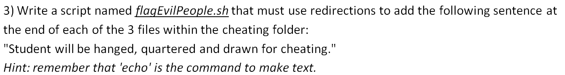
Script practice
#!/bin/bash
echo $'\n'"Student will be hanged, quartered and drawn for cheating." >> ./CSCI330/assign/cheating/1/jeff
echo $'\n'"Student will be hanged, quartered and drawn for cheating." >> ./CSCI330/assign/cheating/1/dan
echo $'\n'"Student will be hanged, quartered and drawn for cheating." >> ./CSCI330/assign/cheating/2/bob
25
Shell programming: variables and conditionals

Slide 26

Conditionals
26
Shell programming: variables and conditionals

Slide 27
Conditionals
Somewhat compact style:
if [ test ] ; then consequence ; fi
or with a bit of formatting...
if [ test ]
then
consequence
fi
Something that’s true or false
Anything
They do exactly the same. Use whichever you want.
27
Shell programming: variables and conditionals

Slide 28
Conditionals
Tests for numbers or strings
Meaning | Numeric | String
Greater than | -gt
Greater than or equal | -ge
Less than | -lt
Less than or equal | -le
Equal | -eq | =
Not equal | -ne | !=
String length is zero |  | -z str
String length is non-zero |  | -n str
file1 is newer than file2 |  | file1 -nt file2
file1 is older than file2 |  | file1 -ot file2
28
Shell programming: variables and conditionals

Slide 29
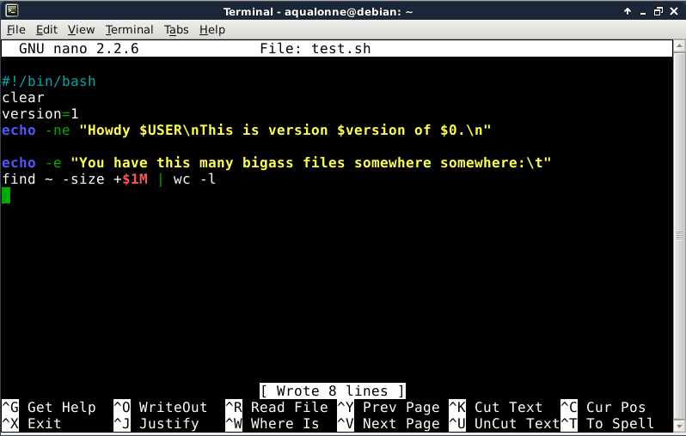
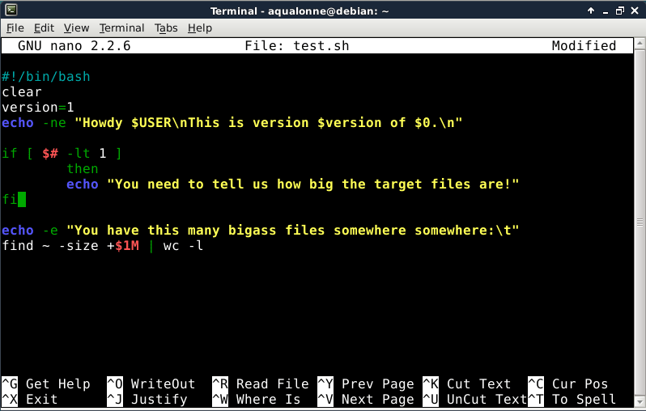
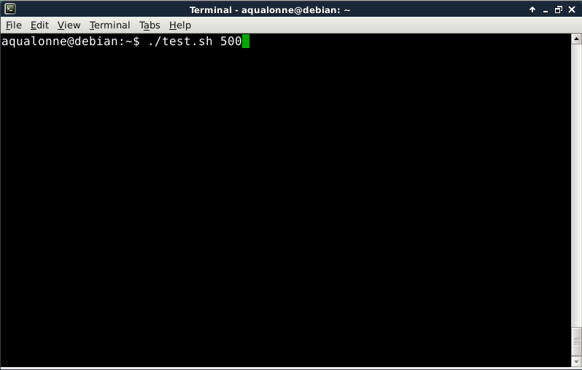
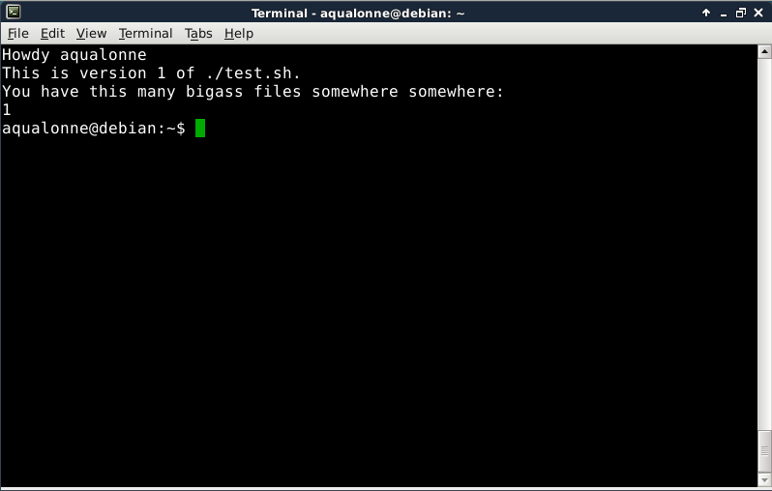
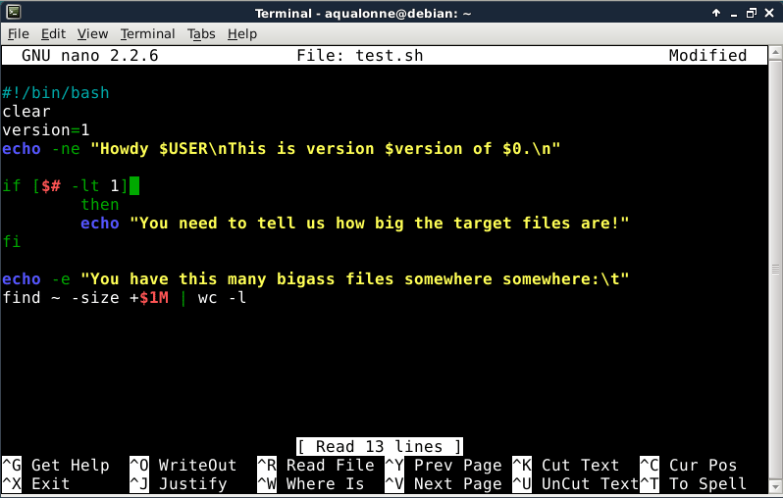
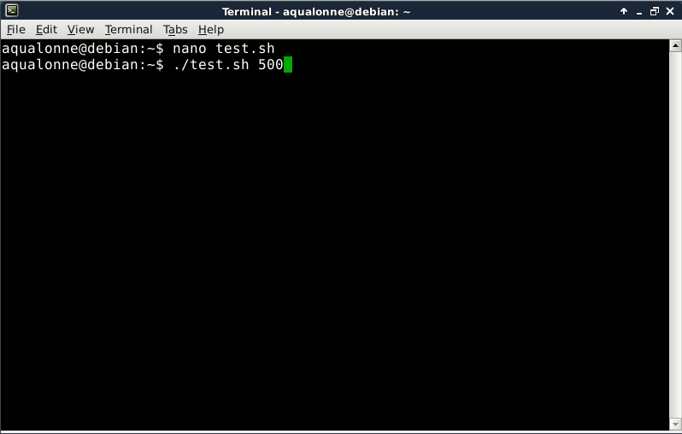
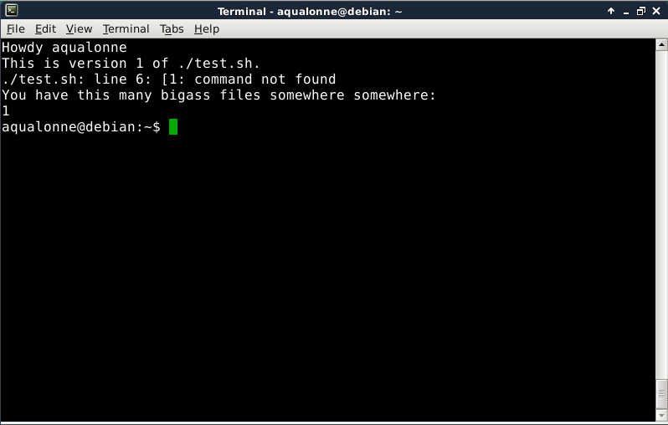
Conditionals
Here is the program as it stands currently. If we want to tell the user that we need at least one argument, what should we do?
Space around [ ]
And what if I don’t put the space...
29
Shell programming: variables and conditionals

Slide 30








Conditionals
What do you think it’ll do if we don’t give it an argument now?
if [ test ]
then
consequence
elif [ test ]
then
consequence
elif [ test ]
then
consequence
else
consequence
fi
Whiny...
If we don’t get 1 arg, notify the user and don’t try.
I we get 1 arg, do it.
...is there any case we’re forgetting here?
But tries anyway and starts throwing out errors
30
Shell programming: variables and conditionals

Slide 31
Conditionals
if [ test ]
then
consequence
else
if [ test ]
then
consequence
else
if [ test ]
then
consequence
else
consequence
fi
fi
fi
if [ test ]
then
consequence
else
if [ test ]
then
consequence
elif [ test ]
then
consequence
else
consequence
fi
fi
if [ test ]
then
consequence
elif [ test ]
then
consequence
elif [ test ]
then
consequence
else
consequence
fi
You can also have nested conditionals. But do it when necessary, not just to waste space ☺
31
Shell programming: variables and conditionals

Slide 32


Conditionals
32
Shell programming: variables and conditionals

Slide 33
Script practice
1) Write a script that takes as argument a folder name. If no argument is provided, tell the user one is needed. If two arguments are provided, tell the user we need only one. If one argument is provided, then make a folder with that name.
#!/bin/bash
if [ “$#” –eq 0 ]
then
echo “Dumb user, give me a folder name”
elif [ “$#” –ge 2 ]
then
echo “So generous! But I only need one argument “
else
mkdir $1
fi
#!/bin/bash
if [ “$#” –eq 0 ] ; then echo “Dumb user, give me a folder name” ; fi
if [ “$#” –ge 2 ] ; then echo “So generous! But I only need one argument “ ; fi
if [ “$#” –eq 1 ] ; then mkdir $1 ; fi
33
Shell programming: variables and conditionals

Slide 34





Script practice
34
Shell programming: variables and conditionals

Slide 35

Script practice
Note that -d tests if a directory exists and -f tests if a file exists, e.g.
if [ -d CSCI330/assign ]
tests if the folder assign exists, and
if [ -f CSCI/assign/mine/1/ans ]
tests if file ans exists.
35
Shell programming: variables and conditionals

Slide 36

Script practice
#!/bin/bash
flag="true"
if [ -d "CSCI330" ]
then
cd CSCI330
else
flag="false"
echo "CSCI330 directory does not exist"
fi
if [ "$flag" == "true" ]
then
if [ -d "lectures" ]
then
cd lectures
if [ -d "1" ]
then
cd 1
if [ -e "1-a" ]
then
if [ -e "1-b" ]
then
if [ ! -e "1-c" ]
then
flag="false"
echo "CSCI330/lectures/1/1-c file does not exist"
fi
else
You could use exit to stop earlier
and simplify the code’s structure.
36
Shell programming: variables and conditionals

Slide 37

Script practice
#!/bin/bash
#check to see if CSCI330 exists
if [ ! -d "CSCI330" ]
then
echo "CSCI330 directory does not exist"
exit 1
else
cd "CSCI330"
fi
#check to see if lectures, assign, and stuff
#exist inside of CSCI330
if [ ! -d "lectures" ]
then
echo "lectures directory does not exist"
exit 1
elif [ ! -d "assign" ]
then
echo "assign directory does not exist"
exit 1
elif [ ! -d "stuff" ]
then
echo "stuff directory does not exist"
exit 1
else
cd "lectures"
fi
#check to see if all files and directories
#inside of lectures exist
if [ ! -d "1" ]
then
echo "lectures directory 1 does not exist"
exit 1
elif [ ! -d "2" ]
then
echo "lectures directory 2 does not exist"
exit 1
else
cd "1"
if [ ! -e "1-a" ]
then
echo "lectures file 1-a does not exist"
exit 1
elif [ ! -e "1-b" ]
then
echo "lectures file 1-b does not exist"
exit 1
elif [ ! -e "1-c" ]
then
echo "lectures file 1-c does not exist"
exit 1
else
cd ".."
cd "2"
if [ ! -e "2-a" ]
then
echo "lectures file 2-a does not exist"
exit 1
else
cd ".."
cd ".."
cd "assign"
fi
fi
fi
#check to see if all directories inside of assign exist
if [ ! -d "mine" ]
then
echo "mine directory does not exist"
exit 1
elif [ ! -d "cheating" ]
then
echo "cheating directory does not exist"
exit 1
else
cd "mine"
fi
etc. etc. >160 lines
37
Shell programming: variables and conditionals

Slide 38
Script practice
I don’t need to go in each
folder. I can just test for files and
folders while staying where I am.
Absolute-ish path
38
Shell programming: variables and conditionals

Slide 39
Script practice
#!/bin/bash
if [ ! -d CSCI330 ]
then
echo "Folder CSCI330 missing“
elif [ ! -d CSCI330/lectures ]
then
echo "Folder lectures missing“
elif [ ! -d CSCI330/lectures/1 ]
then
echo "Folder 1 missing“
elif [ ! -f CSCI330/lectures/1/1-a ]
then
echo "File 1-a missing“
elif [ ! -f CSCI330/lectures/1/1-b ]
then
echo "File 1-b missing“
elif [ ! -f CSCI330/lectures/1/1-c ]
then
echo "File 1-c missing“
elif [ ! -d CSCI330/lectures/2 ]
then
echo "Folder 2 missing“
elif [ ! -f CSCI330/lectures/2/2-a ]
then
echo "File 2-a missing“
elif [ ! -d CSCI330/assign ]
then
echo "Folder assign missing“
elif [ ! -d CSCI330/assign/mine ]
then
echo "Folder mine missing“
elif [ ! -d CSCI330/assign/mine/1 ]
then
echo "Folder 1 missing“
elif [ ! -f CSCI330/assign/mine/1/ques ]
then
echo "File ques missing“
elif [ ! -f CSCI330/assign/mine/1/ans ]
then
echo "File ans missing“
elif [ ! -d CSCI330/assign/mine/2 ]
then
echo "Folder 2 missing“
elif [ ! -f CSCI330/assign/mine/2/ques ]
then
echo "File ques missing“
elif [ ! -f CSCI330/assign/mine/2/ans ]
... Then a miracle occurs ...
else
echo "All is well"
fi
≈ 90 lines
39
Shell programming: variables and conditionals

Slide 40
Script practice
I CAN BE MORE LAZY
I CAN DO IT in 27 LINES
40
Shell programming: variables and conditionals

Slide 41



Variables and conditionals
We are going to create a script to do the following:
Count the number of files in the tmp folder within home
If there are more than 10 files (including hidden files), then add the list to cleaned.log and remove them all.
Here is the list of commands we have learned, and that are relevant:
cd
ls
head
rm
wc
tail
We’ll do it in a roundabout way to practice scripts. Later I’ll show you to use the command find to do it much better!
41
Shell programming: variables and conditionals

Slide 42









Variables and conditionals
Count the number of files
42
Shell programming: variables and conditionals

Slide 43
Variables and conditionals
We are going to create a script to do the following:
Count the number of files in the tmp folder within home
If there are more than 10 files (including hidden files), then add the list to cleaned.log and remove them all.
Here is the list of commands we have learned, and that are relevant:
cd
ls
head
rm
wc
tail
43
Shell programming: variables and conditionals

Slide 44



Variables and conditionals
Are there more than 10 files?
44
Shell programming: variables and conditionals

Slide 45
Variables and conditionals
We are going to create a script to do the following:
Count the number of files in the tmp folder within home
If there are more than 10 files (including hidden files), then add the list to cleaned.log and remove them all.
Here is the list of commands we have learned, and that are relevant:
cd
ls
head
rm
wc
tail
45
Shell programming: variables and conditionals

Slide 46





Variables and conditionals
Count the files in ~/tmp
If there are more than 10
add the list to a log
remove them
46
Shell programming: variables and conditionals

Slide 47


Variables and conditionals
Doing it the first time can feel a bit heavy...
It gets better over time as for any programming task because you start seeing familiar situations, so you know what to do
If you’re not 100% then decompose the problem into smaller tasks, make sure that your script works for each of them, and keep building it piece by piece
47
Shell programming: variables and conditionals

Slide 48
Variables and conditionals
$( ) is to evaluate an expression.
Example: do a bunch of operations, throw the result into a variable
“$name” uses the variable’s value. E.g. as argument, for conditions...
$(( )) is for arithmetic but $[ ] does it too
Example: adding, dividing variables, ...
48
Shell programming: variables and conditionals

Slide 49

Variables and conditionals
If you start seeing $ everywhere, don’t worry, it’s ok, you’re just learning Linux.
49
Shell programming: variables and conditionals

Slide 50

Variables and conditionals
This gave you a complete overview of what you may do in a script, including arithmetic. Note that it can be done simpler. In particular, there are much better ways of counting files.
50
Shell programming: variables and conditionals

Slide 51









Variables and conditionals
51
Shell programming: variables and conditionals

Slide 52

Script practice
52
Shell programming: variables and conditionals

Slide 53
Script practice
#!/bin/bash
#creates a 3 variables. theFile which contains the path to the file in argument 1
#the sentence that is being checked for, and the last line in the file that was passed
#in through argument 1.
theFile="$1"
sentence=$(echo -e "Students will be hanged, quartered and drawn for cheating.")
sentence2=$(tail -1 "$theFile")
#if the searched sentence is equal to the last sentence in the file
#then it displays yes, if not equal then it displays no.
if [ "$sentence" = "$sentence2" ]
then
echo "yes"
else
echo "No"
fi
When do you make a variable?
53
Shell programming: variables and conditionals

Slide 54
Script practice
#!/bin/bash
if [ "$#" -eq "0" ]
then
echo "Must enter one filename as argument"
else
lastLine=$(tail -1 "$1")
if [ "$lastLine" = "Student will be hanged, quartered and drawn for cheating" ]
then
echo "Yes"
else
echo "No"
fi
fi
54
Shell programming: variables and conditionals

Slide 55

Conditionals for programs
The conditions we did so far were all
“if the value is then, then do that”
You could also do
“if this command did not work, then do that”
In other words, parts of the code could run only if other parts succeeded.
55
Shell programming: variables and conditionals

Slide 56











Conditionals for programs
$? is 0 if the last command worked, and 1 if it failed
command1 && command2
executes 2 only if 1 worked
command1 || command2
executes 2 only if 1 failed
Conditional execution
56
Shell programming: variables and conditionals

Slide 57
Script practice
Note that -d tests if a directory exists and -f tests if a file exists, e.g.
[ -d CSCI330/assign ]
tests if the folder assign exists, and
[ -f CSCI/assign/mine/1/ans ]
tests if file ans exists.
57
Shell programming: variables and conditionals

Slide 58
Script practice
I CAN BE MORE LAZY
I DON’T NEED TO MOVE
I CAN USE EXIT
I CAN USE &&
58
Shell programming: variables and conditionals

Slide 59
Script practice
#!/bin/bash
[ ! -e ./CSCI330 ] && echo "CSCI330 does not exist" && exit
[ ! -e ./CSCI330/assign ] && echo "CSCI330/assign does not exist" && exit
[ ! -e ./CSCI330/assign/cheating ] && echo "CSCI330/assign/cheating does not exist" && exit
[ ! -e ./CSCI330/assign/cheating/1 ] && echo "CSCI330/assign/cheating/1 does not exist" && exit
[ ! -e ./CSCI330/assign/cheating/1/dan ] && echo "CSCI330/assign/cheating/1/dan does not exist" && exit
[ ! -e ./CSCI330/assign/cheating/1/jeff ] && echo "CSCI330/assign/cheating/1/jeff does not exist" && exit
[ ! -e ./CSCI330/assign/cheating/2 ] && echo "CSCI330/assign/cheating/2 does not exist" && exit
[ ! -e ./CSCI330/assign/cheating/2/bob ] && echo "CSCI330/assign/cheating/2/bob does not exist" && exit
[ ! -e ./CSCI330/assign/mine ] && echo "CSCI330/assign/mine does not exist" && exit
[ ! -e ./CSCI330/assign/mine/1 ] && echo "CSCI330/assign/mine/1 does not exist" && exit
[ ! -e ./CSCI330/assign/mine/1/ans ] && echo "CSCI330/assign/mine/1/ans does not exist" && exit
[ ! -e ./CSCI330/assign/mine/1/ques ] && echo "CSCI330/assign/mine/1/ques does not exist" && exit
[ ! -e ./CSCI330/assign/mine/2 ] && echo "CSCI330/assign/mine/2 does not exist" && exit
[ ! -e ./CSCI330/assign/mine/2/ans ] && echo "CSCI330/assign/mine/2/ans does not exist" && exit
[ ! -e ./CSCI330/assign/mine/2/ques ] && echo "CSCI330/assign/mine/2/ques does not exist" && exit
[ ! -e ./CSCI330/lectures ] && echo "CSCI330/lectures does not exist" && exit
[ ! -e ./CSCI330/lectures/1 ] && echo "CSCI330/lectures/1 does not exist" && exit
[ ! -e ./CSCI330/lectures/1/1-a ] && echo "CSCI330/lectures/1/1-a does not exist" && exit
[ ! -e ./CSCI330/lectures/1/1-b ] && echo "CSCI330/lectures/1/1-b does not exist" && exit
[ ! -e ./CSCI330/lectures/1/1-c ] && echo "CSCI330/lectures/1/1-c does not exist" && exit
[ ! -e ./CSCI330/lectures/2 ] && echo "CSCI330/lectures/2 does not exist" && exit
[ ! -e ./CSCI330/lectures/2/2-a ] && echo "CSCI330/lectures/2/2-a does not exist" && exit
[ ! -e ./CSCI330/stuff ] && echo "CSCI330/stuff does not exist" && exit
[ ! -e ./CSCI330/stuff/linuxjokes ] && echo "CSCI330/stuff/linuxjokes does not exist" && exit
echo "All is well"
27 lines
^ ^
59
Shell programming: variables and conditionals

Slide 60

60
Shell programming: variables and conditionals

Slide 61

Practice questions & activities
We recommend that you do these, but that’s for your own good, not graded.
Change the script on slide 44 so that it produces two logs: moved.log in which it adds the names of the files that were moved, and errors.log in which it adds the names of that files that could not be moved.
From scratch, write a script moveIfNotFull that will move a file into a directory only if that directory contains less than X files, where X is given as argument.
For example, if we write
./moveIfNotFull.sh bad.log ./tmp 10
and ./tmp has already 10 files or more, then bad.log should not be moved.
3a) From scratch, write a script countTogether that takes as arguments two folders and displays the number of files in the two folders. For example, if not folder has 5 files and the other has 10, we should see 15.
3b) Continuing from the script in 3a), modify it such that the number of files is exported to the shell. For example, if we write echo”$totalFiles” we should see 15 in the shell.
61
Shell programming: variables and conditionals

Slide 62












To go further… examples regarding variable scope
These examples show you that there is a scope and that you can play with it.
In practice, you rarely will.
62
Shell programming: variables and conditionals

